Slide 1
Python samples
For beginners

Slide 2
Working with numbers and operators
Different types of operators
Multiplication: *
Division: /
Addition: +
Subtraction: -
Different types of operators
Exponents: **
Modulus: %
Floor: //
Order of Operations
Parenthesis – Exponents – Multiplication – Division – Addition – Subtraction

Slide 3
Working with numbers and operators (Practice)
print(5+2) = ?
print(5*2) = ?
print(5**2) = ?
print(5/2) = ?
print(5+2) = ?
print(5–2) = ?
print(5//2) = ?
Floor: does not provide the remainder
print(5%2) = ?
Modulus: provides the remainder
Working with large numbers:
print(1,000,000)
print(1000000) instead

Slide 4
Working with texts and strings
You may use single or double quotes
Example:
“” or ‘’
Practice
print(‘whats up?’): Use of single quotes
print(“What’s Up?”): Use of double quotes

Slide 5
Working with comments
Use # in order to comment out lines of code
Python does not execute commented lines
Practice
print(“What’s Up? “) #comment to describe code
Comment out lines of code
# print(“What’s up? “)

Slide 6
Working with variables
Variable: a variable is a value that can change, depending on conditions or on information passed to the program
Must contain letters, numbers, or underscores
Should not start with a number
Spaces are not allowed
Cannot be keywords (e.g, print, try, break)
Short & descriptive are best (e.g., first_Name)
Case sensitive

Slide 7
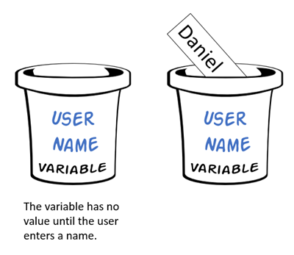
Working with variables
Algebra: X = 24
X = “String”
X = Integer

Slide 8
Working with variables (Practice)
bucket = “Eric”
print(Bucket)

Slide 9
Working with variables (Practice)
bucket = “Eric”
bucket = 10
print(Bucket)

Slide 10
Working with variables (Practice)
Data Types: the classification or categorization of data items
Integer → int (whole numbers)
Strings → str (texts)
Boolean → 1 or 0, True of False
Floats → Decimal

Slide 11
Working with variables (Practice)
bucket = “Eric”
bucket = 10
print(type(bucket))

Slide 12
Working with variables (Practice)
Input(): Takes input from the user and stores it into a variable
bucket = input(“What is your name? ”)
print(bucket)

Slide 13
Working with variables (Practice)
#Input(): Takes input from the user and stores it into a variable
bucket1 = input(“Enter first number? ”)
bucket2 = input(“Enter second number? “)
print(bucket1 + bucket2)

Slide 14
Working with variables (Practice)
#Input(): Takes input from the user and stores it into a variable
bucket1 = input(“Enter first number? ”)
bucket2 = input(“Enter second number? “)
print(int(bucket1) + int(bucket2))

Slide 15
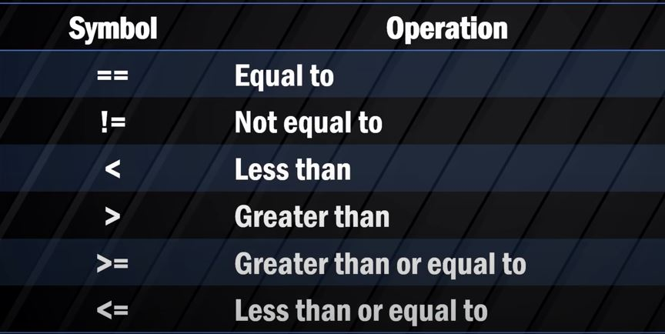
Working with conditional logic
Conditional Operators: Are the conditional expressions used to give the output according to the condition in the expression

Slide 16
Working with conditional logic (Practice)
Conditional Operators
print(5 == 4) →
print(5 != 4) →
print(5 < 4) →
Conditional Operators
print(5 > 4) →
print(5 >= 4) →
print(5 <= 4) →

Slide 17
Working with conditional logic (Practice)
Assign some variables:
User_Age = 24
Age_President = 35
Compare Variables:
print(User_Age == Age_President)
print(User_Age != Age_President)
print(User_Age > Age_President)
print(User_Age < Age_President)
print(User_Age >= Age_President)
print(User_Age <= Age_President)

Slide 18
Working with if statements
Decides whether certain statements need to be executed or not.

Slide 19
Working with if statements (Practice)
Assign some variables:
User_Age = 24
Age_President = 35
A formatted string literal or f-string is a string literal that is prefixed with f or F . These strings may contain replacement fields, which are expressions delimited by curly braces {}
Compare Variables:
if User_Age < Age_President:
print(f"You are {User_Age}, and you're too young to run for president")
print("You are", user_age, "and you're too young to run for president")

Slide 20
Working with if statements (Practice)
Assign some variables:
User_Age = 24
Age_President = 35
An else statement contains the block of code that executes if the conditional expression in the if statement resolves to 0 or a FALSE value. The else statement is an optional statement and there could be at most only one else statement following if
Compare Variables:
if User_Age < Age_President:
print(f"You are {User_Age}, and you're too young to run for president")
else:
print(f"You are {User_age} and old enough to run for president or another office")

Slide 21
Working with if statements (Practice)
Assign some variables:
User_Age = 24
Age_President = 35
elif short for "else if" and is used when the first if statement isn't true, but you want to check for another condition
Compare Variables:
if User_Age < Age_President:
print(f"You are {User_Age}, and you're too young to run for president")
elif User_Age == Age_President:
Print(f“Enjoy running for the presidencyat {User_age}”)
else:
print(f"You are {User_age} and old enough to run for president or another office")

Slide 22
Working with functions
A function is a block of code which only runs when it is called.
You can pass data, known as parameters, into a function.
A function can return data as a result.
Can be called throughout the body of code
Examples of built-in functions:
print()
input()

Slide 23
Working with functions
print(“roadrunners are the best”)
print(“roadrunners are the best”)
print(“roadrunners are the best”)

Slide 24
Working with functions
Step 1: Define a function
def my_function():
Step 2: Call a function
my_function()

Slide 25
Working with functions (practice)
Before
print(“roadrunners are the best”)
print(“roadrunners are the best”)
print(“roadrunners are the best”)
After: Define and Call
Define the function first
Def my_function():
text = “Roadrunners are the best”
Print(text)
Print(text)
Print(text)
Call the function second
my_function()

Slide 26
Working with functions (Practice)
Before
Def my_function():
text = (“roadrunners are the best”)
Print(text)
Print(text)
Print(text)
my_function()
After: Passing values for arguments
Def my_function(text):
Print(text)
Print(text)
Print(text)
my_function(“Roadrunners beat the Redhawks!”)

Slide 27
Working with functions (Practice)
After: Returning Values
Age = input("How old are you? ")
driving_Age = 16
def my_function(Age):
age_diff = driving_Age - int(Age)
return age_diff
Num_of_years = my_function(Age)
print(f"Number of {Num_of_years} to wait until you can drive")
Before
Def my_function(text):
Print(text)
Print(text)
Print(text)
my_function(“Roadrunners beat the Redhawks!”)

Slide 28
Working with loops
For Loop: A for loop in Python is used to iterate over a sequence (list, tuple, set, dictionary, and string).
While Loop: The while loop is used to execute a set of statements as long as a condition is true.
Nested Loop: If a loop exists inside the body of another loop, it is called a nested loop

Slide 29
Working with loops
While Loop:
X = 0
while (X<5):
print(X)
X = X + 1

Slide 30
Working with loops
For Loop:
Range(start, stop, increment)
for X in range(10, 25)
print(X)
for X in range(10, 25)
print(X + 1) → to include last one
for X in range(10, 25, 5)
print(x)
While Loop:
X = 0
while (X<5):
print(X)
X = X + 1

Slide 31
Working with loops
For Loop Strings:
fruits = ["apple", "banana", “grapes"] for x in fruits: print(x)
For Loop Integers:
Range(start, stop, increment)
for X in range(10, 25)
print(X)
for X in range(10, 25, 5)
print(x)

Slide 32
Working with import statements
In Python, you use the “import” keyword to make code in one module available in another
Using imports properly will make you more productive, allowing you to reuse code while keeping your projects maintainable
You need to use the import keyword along with the desired module name. When interpreter comes across an import statement, it imports the module to your current program. You can use the functions inside a module by using a dot(.) operator along with the module name.
The import statement allows you to import all the functions from a module into your code. Often, though, you'll only want to import a few functions, or just one. If this is the case, you can use the from statement

Slide 33
Working with import statements (practice)
Example:
import math
Print(“Pi is”, math.pi)

Slide 34
Working with import statements (practice)
Example:
import math
from datetime import date
Print(“Pi is”, math.pi)
Print(“Today’s date is”, date.today()) #get system date

Slide 35
Working with import statements (practice)
Example:
import socket
hostname = socket.gethostname()
MyIP = socket.gethostbyname(hostname)
print(f"My IP address is {MyIP} and my computer name is {hostname}")

Slide 36
First Program Attempt
Next Steps:
Look to Moodle for your first program assignment

